Slide 1
Predict assessment scores
Sourced from kaggle
Christian Davies
Regis University
https://github.com/chris10davies/MSDS696-Data-Science-Practicum

Slide 2


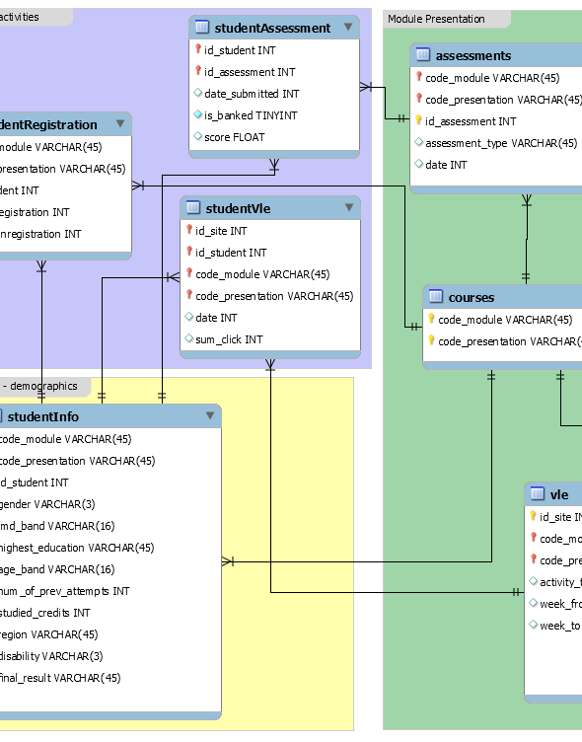
PROJECT OVERVIEW
28785
28785
Open University Learning Analytics Dataset
From Kaggle
7 courses
28,785 students
Assessment results
Summaries of student clicks on virtual learning environment (VLE) materials

Slide 3
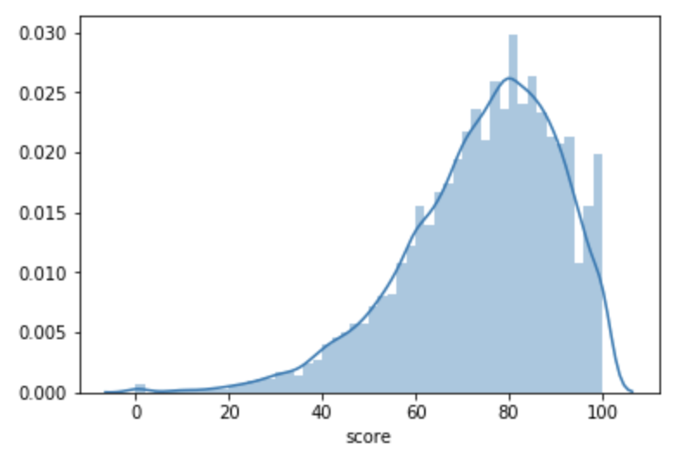
Summary
Data
Joins
Feature Engineering
Exploratory Data Analysis (EDA)
Preprocessing
Supervised Learning – Regression
Supervised Learning Classification
Conclusion/Next Steps

Slide 4
Dataset information
Dataset | Description | Row/Variable
Courses | Modules and there presentations. | 22 rows 3 variables
Assessments | Assessments in module presentations. | 206 rows 6 variables
VLE | Available materials in the virtual learning environment (VLE). | 6364 rows 6 variables
Student Info | Demographic information about students and their final result. | 32,593 rows 12 variables
Student Registration | Student registration information for the module presentation. | 32,593 rows 5 variables
Student Assessment | Results of student assessments. | 173,912 rows 5 variables
Student VLE | Students interactions with materials in the VLE. | 10,655,280 rows 6 variables

Slide 5
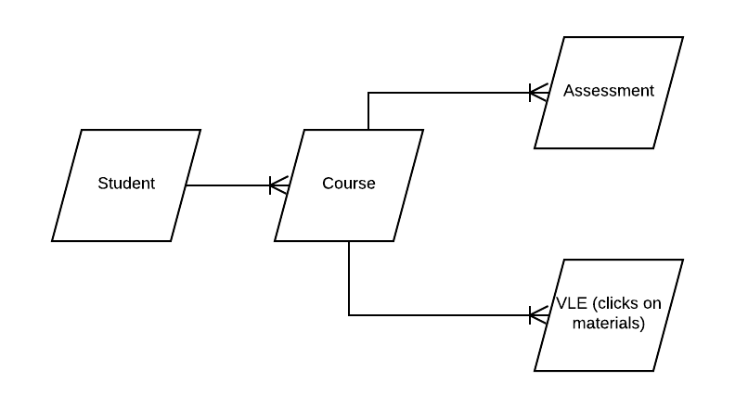
Bringing it all together with joins (challenges)
173,912 assessments with target variable – score
Students have many assessments, several repeated features with different scores
Incorporating material click data

Slide 6
Bringing it all together with joins (2 versions of ML dataset)
Assessment Dataset (less features, more rows)
Description | All assessments with many repeated features (many assessments per student) and different outcome score.
Records removed | Withdrawals Records with missing IMD_Band
Structure | 153,537 rows 19 features
Click Dataset (more features, less rows)
Description | Average score per student and total clicks broken out by course activity type.
Records removed | Withdrawals Records with missing IMD_Band
Structure | 37,030 rows 38 features

Slide 7
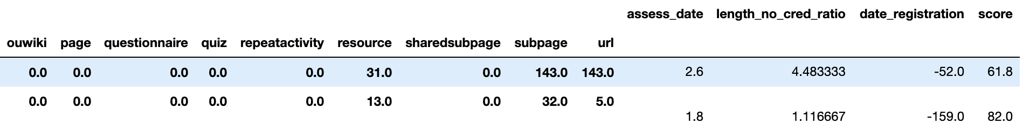
Feature engineering
Total clicks by activity type by student (e.g. page, questionnaire, quiz…click dataset only).
Average Click – Average clicks across all activity types for a student (click dataset only).
Access date - date minus date submitted for both datasets. Date is the final date to complete assessment and date submitted is when it was taken.
Module length to number of credits ratio - length of module presentation in days divided by the number of credits for the module (both datasets).

Slide 8

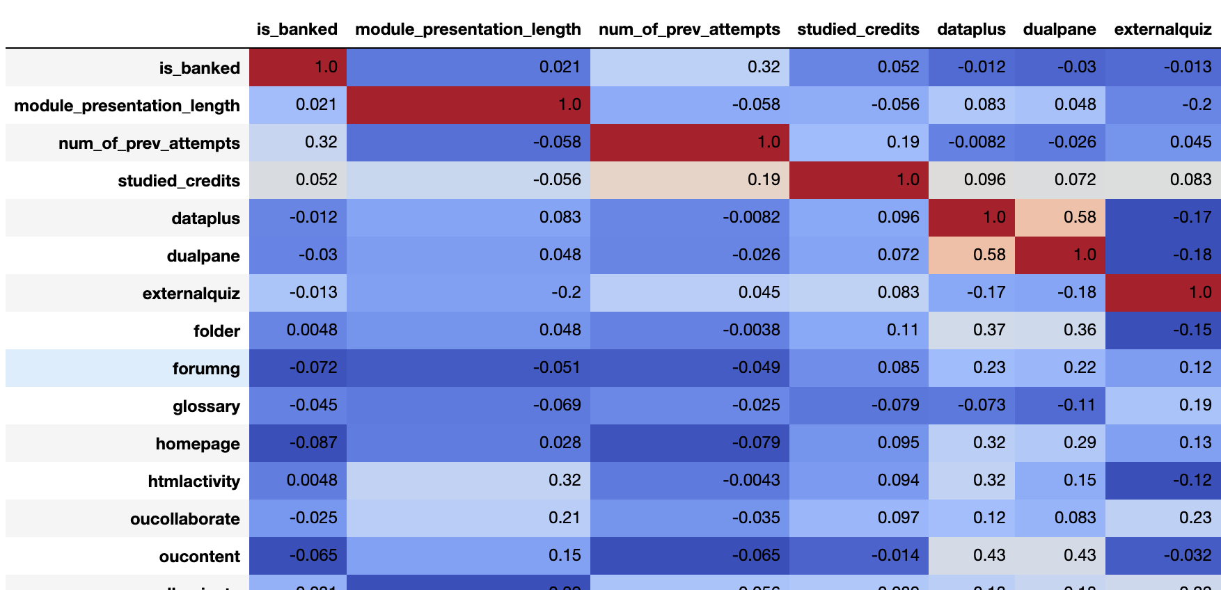
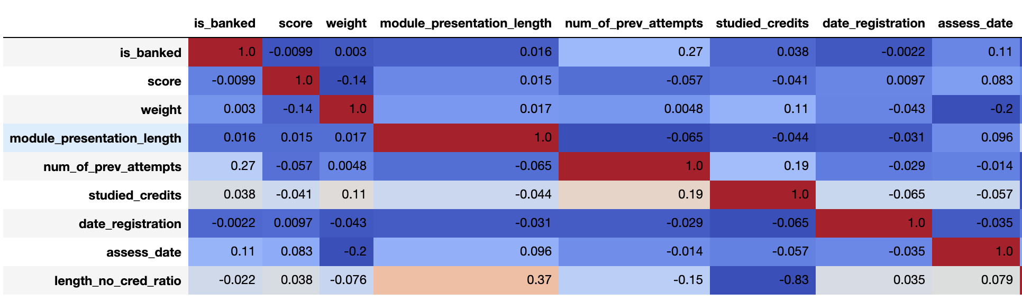
Eda – correlation matrix
Click Dataset
Assessment Dataset

Slide 9
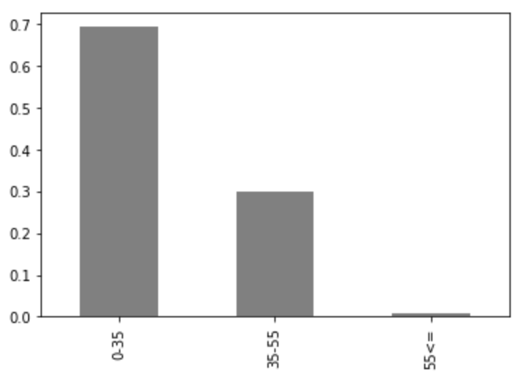
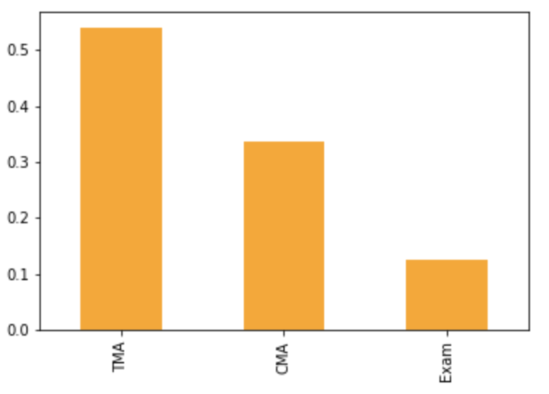
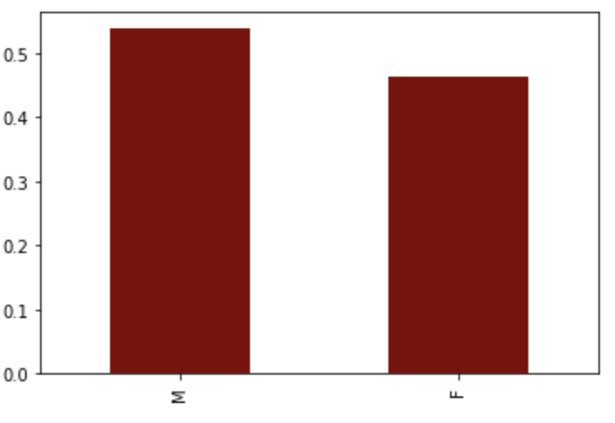
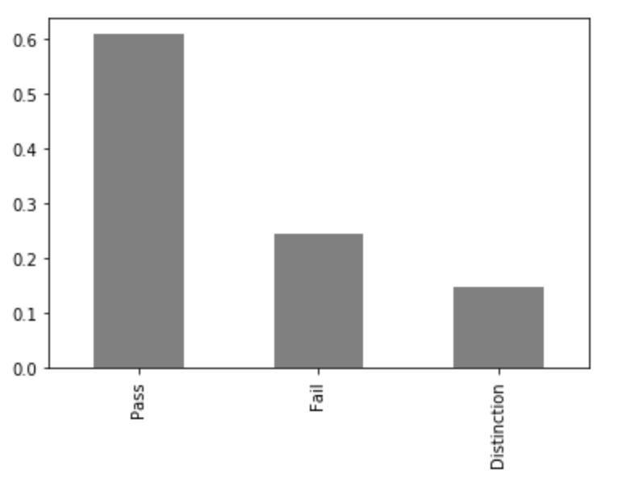
Eda – Bar plots
Age
Assessment Type
Gender
Final Result

Slide 10
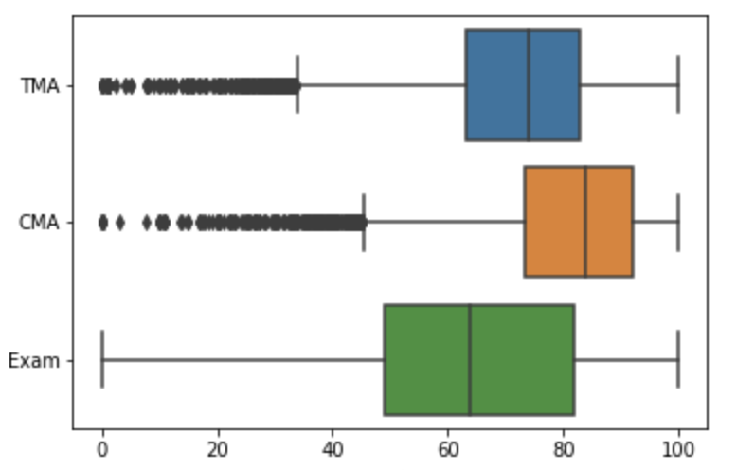
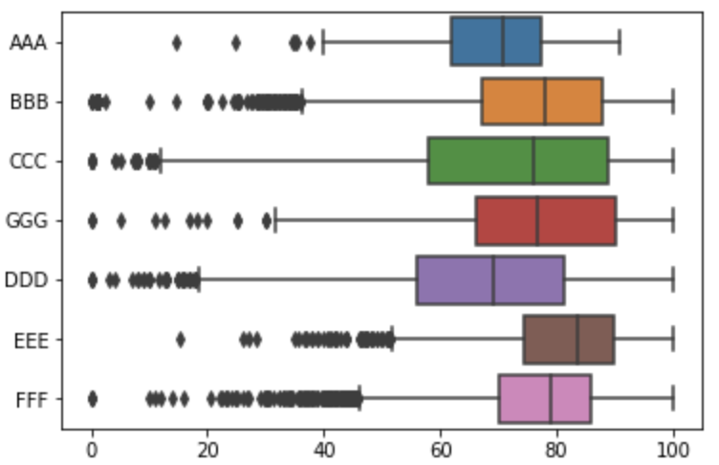
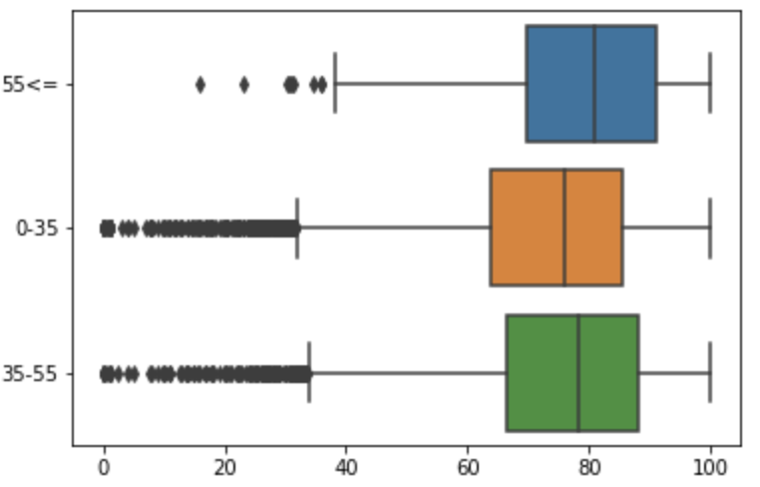
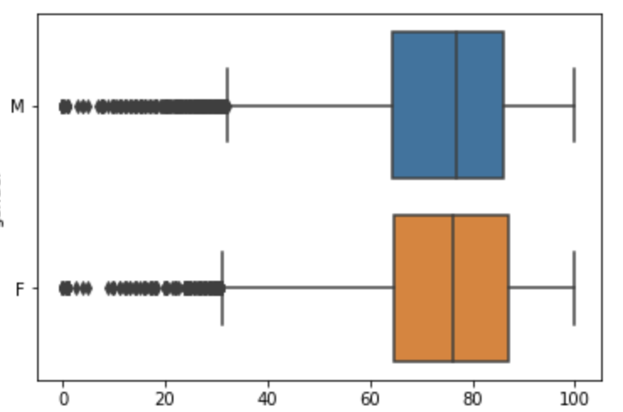
Eda – boxplots
Assessment Type/Score
Course Module/Score
Age/Score
Gender/Score

Slide 11
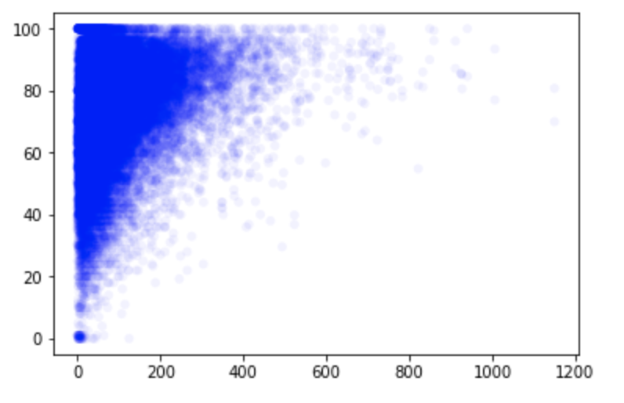
Eda – scatter average clicks

Slide 12
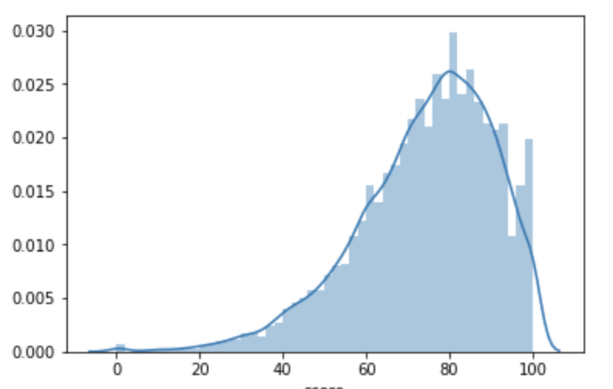
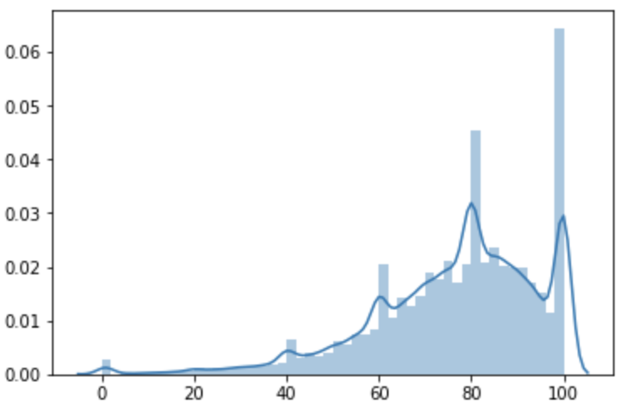
Eda – score distribution
Click Dataset
Assessment Dataset

Slide 13
Machine learning – preprocessing
Imputed medians in assess date and score on assessment dataset.
Chose not to remove outliers as they are valid scores.
Imputed median on zero clicks to reduce extreme variance
Used pandas get_dummies to convert categorical features to numbers
Train Test split

Slide 14
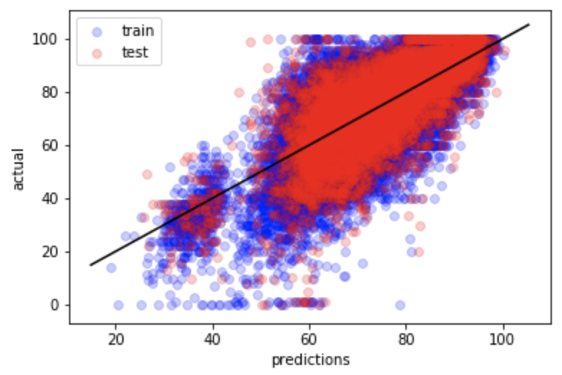
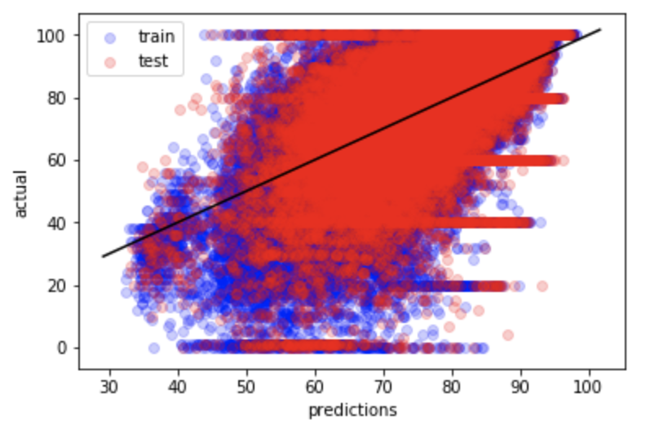
Supervised learning – regression
Hyperparameter Tuning - GridSearchCV:
Click Dataset – Top 3 Models
Assessment Dataset – Top 3 Models
Model | Adjusted r2 | RMSE
Random Forest Regressor | 0.5049 | 11.4554
Neural Net | 0.4628 | 11.9323
XGBoost | 0.5278 | 11.1868
Model | Adjusted r2 | RMSE
Random Forest Regressor | 0.3748 | 14.4142
Neural Net | 0.3308 | 14.9135
XGBoost | 0.3455 | 14.7488

Slide 15
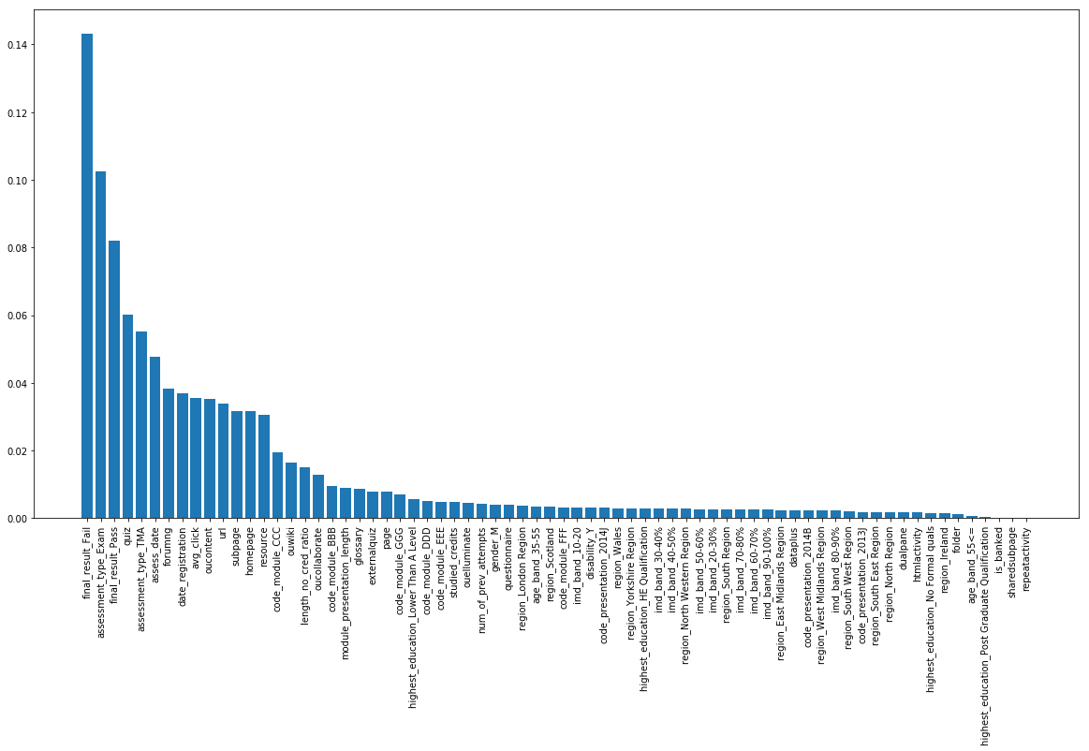
RANDOM FOREST – IMPORTANT FEATURES
Model | Adjusted r2 | RMSE
Random Forest Regressor Dropped unimportant features | 0.5250 | 11.2207
Top 3 models

Slide 16
SUPERVISED LEARNING – classification
Utilized Click Dataset to try Classification:
Target = Final_Result (Pass/Fail)
Converted target to number with LabelEncoder
GridSearchCV used for hyperparameter to select best parameters
Model | Kappa | AUC
Logistic Regression | 0.4750 | 0.85567
Random Forest Classifier | 0.6020 | 0.91729

Slide 17
conclusion
Sub par regression model results, more features could improve scores
Regression models had much better results on click dataset (more features, less rows) than the assessment dataset (less features, more rows)
GridSearchCV worked great to identify optimal parameters - Further hypertuning may improve results while being cautious about overfitting
Predicting assessment scores would have been easier if there was one score per student, made things complex
Ensemble models are powerful and produce impressive results
It makes sense that classification performed better than regression, as binary classification had a 50% chance of making correct prediction
Many of the feature engineered variables ended up being important features to the model, amazing how combinations of various features can improve a model

Slide 18
Next steps
Further tuning of GridSearchCV optimal parameters
More feature engineering to improve scores

Slide 19
reference
Aaron. (2014, August 12). How are kappa and overall accuracy related with respect to thematic raster data? Retrieved from https://gis.stackexchange.com/questions/110188/how-are-kappa-and-overall-accuracy-related-with-respect-to-thematic-raster-data
Editor, M. B. (2013, May 30). Regression Analysis: How Do I Interpret R-squared and Assess the Goodness-of-Fit? Retrieved from https://blog.minitab.com/blog/adventures-in-statistics-2/regression-analysis-how-do-i-interpret-r-squared-and-assess-the-goodness-of-fit
Editor, M. B. (2013, June 13). Multiple Regression Analysis: Use Adjusted R-Squared and Predicted R-Squared to Include the Correct Number of Variables. Retrieved from https://blog.minitab.com/blog/adventures-in-statistics-2/multiple-regession-analysis-use-adjusted-r-squared-and-predicted-r-squared-to-include-the-correct-number-of-variables
Flexible education of the highest standard. (n.d.). Retrieved from http://www.open.ac.uk/
https://github.com/chris10davies/MSDS696-Data-Science-Practicum
Kuzilek J., Hlosta M., Zdrahal Z. Open University Learning Analytics dataset Sci. Data 4:170171 doi: 10.1038/sdata.2017.171 (2017).
Narkhede, S. (2018, June 26). Understanding AUC - ROC Curve. Retrieved from https://towardsdatascience.com/understanding-auc-roc-curve-68b2303cc9c5
RMSE: Root Mean Square Error. (2017, November 14). Retrieved from https://www.statisticshowto.datasciencecentral.com/rmse/
Russell, R. (2018, October 27). Open University Learning Analytics Dataset. Retrieved from https://www.kaggle.com/rocki37/open-university-learning-analytics-dataset

Slide 20
Thank you

